Slide 1
Chapter 27
Current and Resistance

Slide 2
Electric Current
Most practical applications of electricity deal with electric currents.
  The electric charges move through some region of space.
The resistor is a new element added to circuits.
Energy can be transferred to a device in an electric circuit.
The energy transfer mechanism is electrical transmission, T_{ET.}
Introduction

Slide 3
Electric Current
Electric current is the rate of flow of charge through some region of space.
The SI unit of current is the ampere (A).
  1 A = 1 C / s
The symbol for electric current is I.
That is, 1 A of current is equivalent to 1 C of charge passing through a surface in 1 s.
Section 27.1

Slide 4
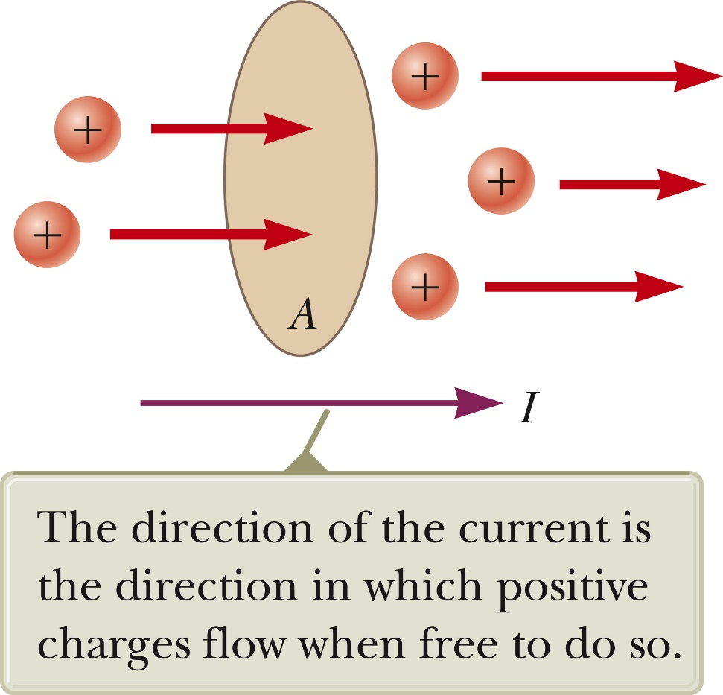

Average Electric Current
Assume charges are moving perpendicular to a surface of area A.
If ΔQ is the amount of charge that passes through A in time Δt, then the average current is
Section 27.1

Slide 5

Instantaneous Electric Current
If the rate at which the charge flows varies with time, the instantaneous current, I, is defined as the differential limit of average current as Δt→0.
Section 27.1

Slide 6
Direction of Current
The charged particles passing through the surface could be positive, negative or both.
It is conventional to assign to the current the same direction as the flow of positive charges.
In an ordinary conductor, the direction of current flow is opposite the direction of the flow of electrons.
It is common to refer to any moving charge as a charge carrier.
Section 27.1

Slide 7
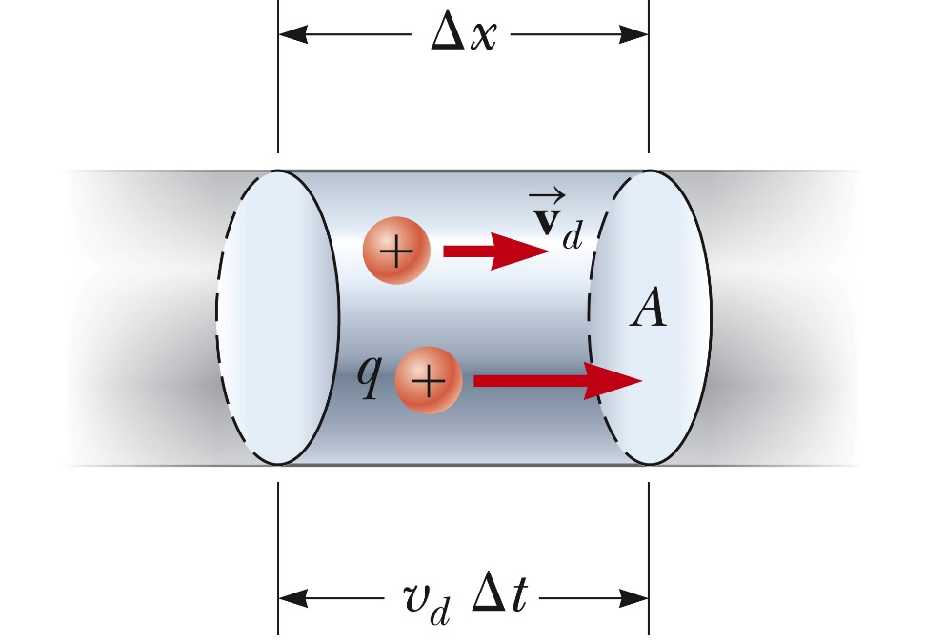
Current and Drift Speed
Charged particles move through a cylindrical conductor of cross-sectional area A.
n is the number of mobile charge carriers per unit volume.
nAΔx is the total number of charge carriers in a segment.
Section 27.1

Slide 8


Current and Drift Speed, cont
The total charge is the number of carriers times the charge per carrier, q.
Assume the carriers move with a velocity parallel to the axis of the cylinder such that they experience a displacement in the x-direction.
If v_{d} is the speed at which the carriers move, then
  v_{d} = Δx / Δt and Δx = v_{d} Δt
Rewritten: ΔQ = (nAv_{d} Δt)q
Finally, current
v_{d} is an average speed called the drift speed.
Section 27.1

Slide 9
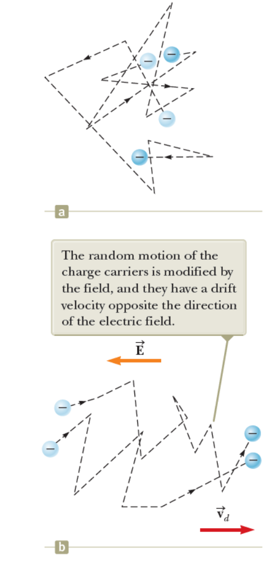
Charge Carrier Motion in a Conductor
If the conductor is isolated—that is, the potential difference across it is zero—these electrons undergo random Motion. The electrons collide repeatedly with the metal atoms, and their resultant motion is complicated and zigzagged Fig. a.
When a potential difference is applied across the conductor, an electric field is set up in the conductor which exerts an electric force on the electrons.
The motion of the electrons is no longer random.
The zigzag black lines represents the motion of a charge carrier in a conductor in the presence of an electric field.
  The net drift speed is small.
The sharp changes in direction are due to collisions.
The net motion of electrons is opposite the direction of the electric field.
Section 27.1

Slide 10

Motion of Charge Carriers, cont.
In the presence of an electric field, in spite of all the collisions, the charge carriers slowly move along the conductor with a drift velocity,
The electric field exerts forces on the conduction electrons in the wire.
These forces cause the electrons to move in the wire and create a current.
Section 27.1

Slide 11
Motion of Charge Carriers, final
The electrons are already in the wire.
They respond to the electric field set up by the battery.
The battery does not supply the electrons, it only establishes the electric field.
Section 27.1

Slide 12
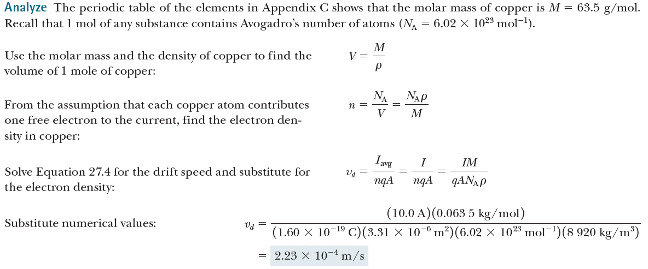
Drift Velocity, Example
12-guage wire has cross sectional area of 3.31 mm²
Section 27.1
Notes:
http://www.engineeringtoolbox.com/awg-wire-gauge-d_731.html

Slide 13
Current Density
J is the current density of a conductor.
It is defined as the current per unit area.
  J ≡ I / A = nqv_{d}
  This expression is valid only if the current density is uniform and A is perpendicular to the direction of the current.
J has SI units of A/m²
The current density is in the direction of the positive charge carriers.
Section 27.2

Slide 14
Conductivity
A current density and an electric field are established in a conductor whenever a potential difference is maintained across the conductor.
For some materials, the current density is directly proportional to the field.
The constant of proportionality, σ, is called the conductivity of the conductor.
Section 27.2

Slide 15
Ohm’s Law
Ohm’s law states that for many materials, the ratio of the current density to the electric field is a constant σ that is independent of the electric field producing the current.
  Most metals obey Ohm’s law
  Mathematically, J = σ E
  Materials that obey Ohm’s law are said to be ohmic
  Not all materials follow Ohm’s law
    Materials that do not obey Ohm’s law are said to be nonohmic.
Ohm’s law is not a fundamental law of nature.
Ohm’s law is an empirical relationship valid only for certain materials.
Section 27.2

Slide 16
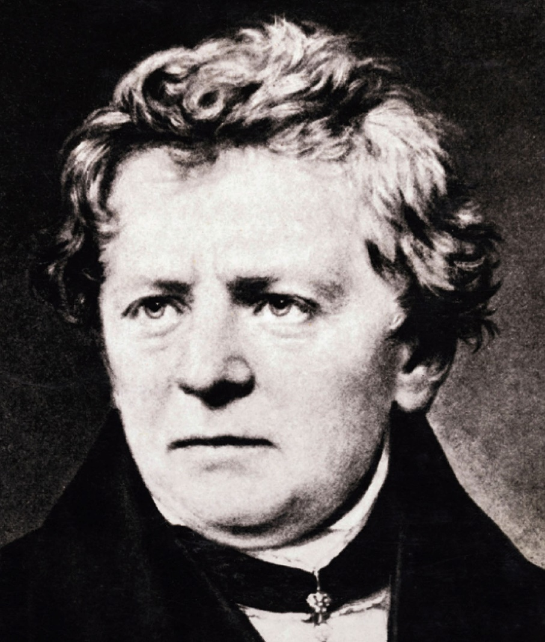
Georg Simon Ohm
1789 -1854
German physicist
Formulated idea of resistance
Discovered the proportionalities now known as forms of Ohm’s Law
Section 27.2

Slide 17
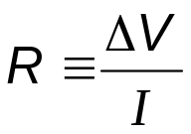
Resistance
In a conductor, the voltage applied across the ends of the conductor is proportional to the current through the conductor.
The constant of proportionality is called the resistance of the conductor.
SI units of resistance are ohms (Ω).
  1 Ω = 1 V / A
Resistance in a circuit arises due to collisions between the electrons carrying the current with the fixed atoms inside the conductor.
Section 27.2

Slide 18
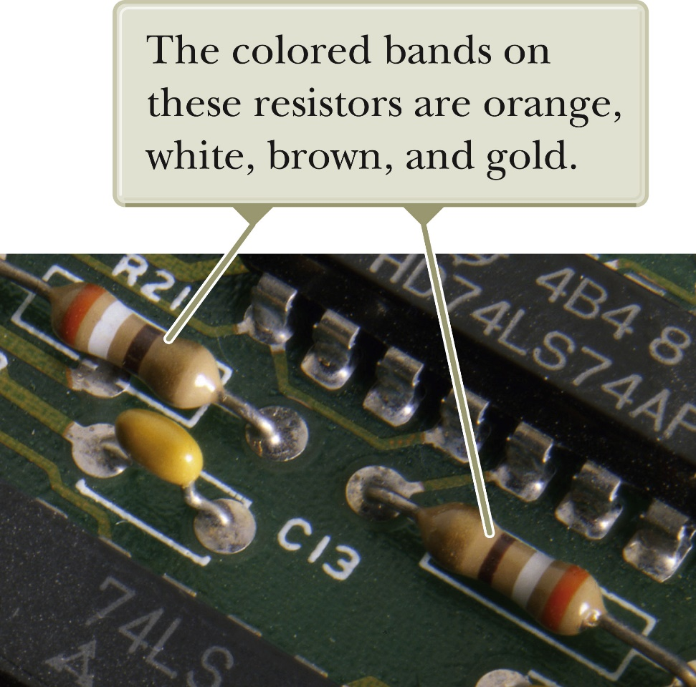
Resistors
Most electric circuits use circuit elements called resistors to control the current in the various parts of the circuit.
Stand-alone resistors are widely used.
  Resistors can be built into integrated circuit chips.
Values of resistors are normally indicated by colored bands.
  The first two bands give the first two digits in the resistance value.
  The third band represents the power of ten for the multiplier band.
  The last band is the tolerance.
Section 27.2

Slide 19
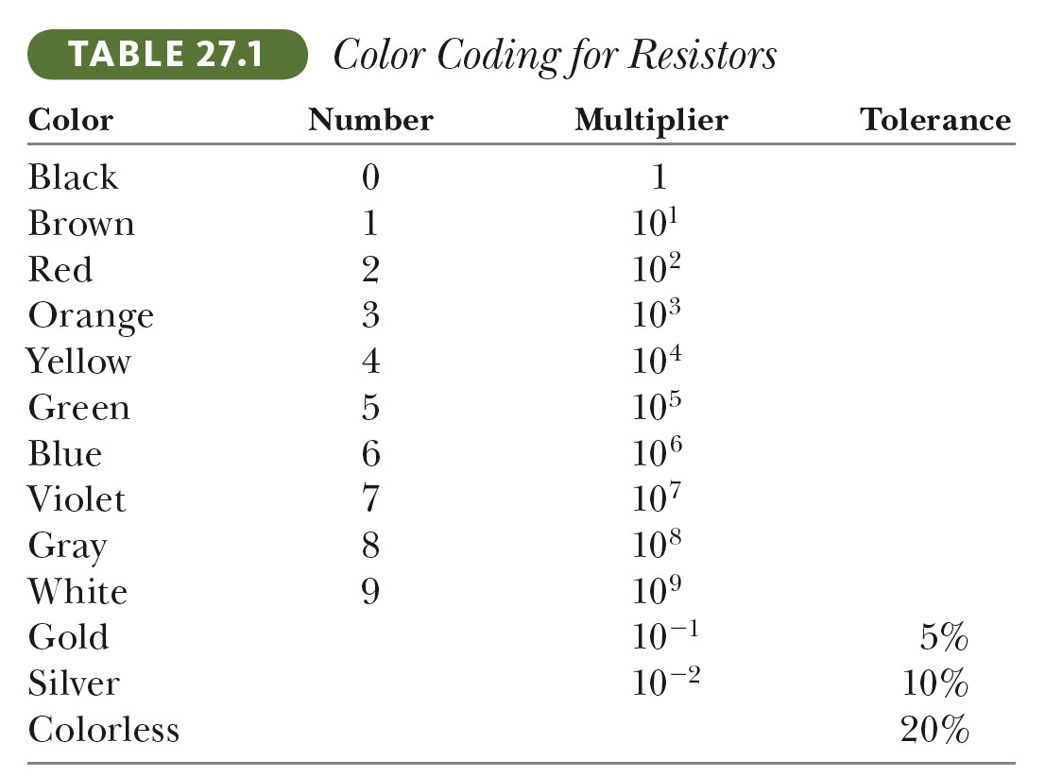
Resistor Color Codes
Section 27.2

Slide 20
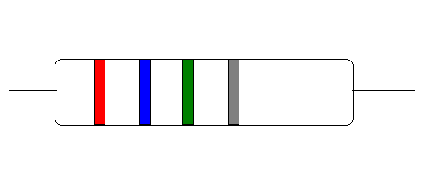
Resistor Color Code Example
Red (=2) and blue (=6) give the first two digits: 26
Green (=5) gives the power of ten in the multiplier: 10⁵
The value of the resistor then is 26 x 10⁵ Ω (or 2.6 MΩ)
The tolerance is 10% (silver = 10%) or 2.6 x 10⁵ Ω
Section 27.2

Slide 21
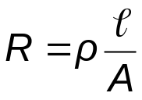
Resistivity
The inverse of the conductivity is the resistivity:
  ρ = 1 / σ
Resistivity has SI units of ohm-meters (Ω . m)
Resistance is also related to resistivity:
Section 27.2

Slide 22
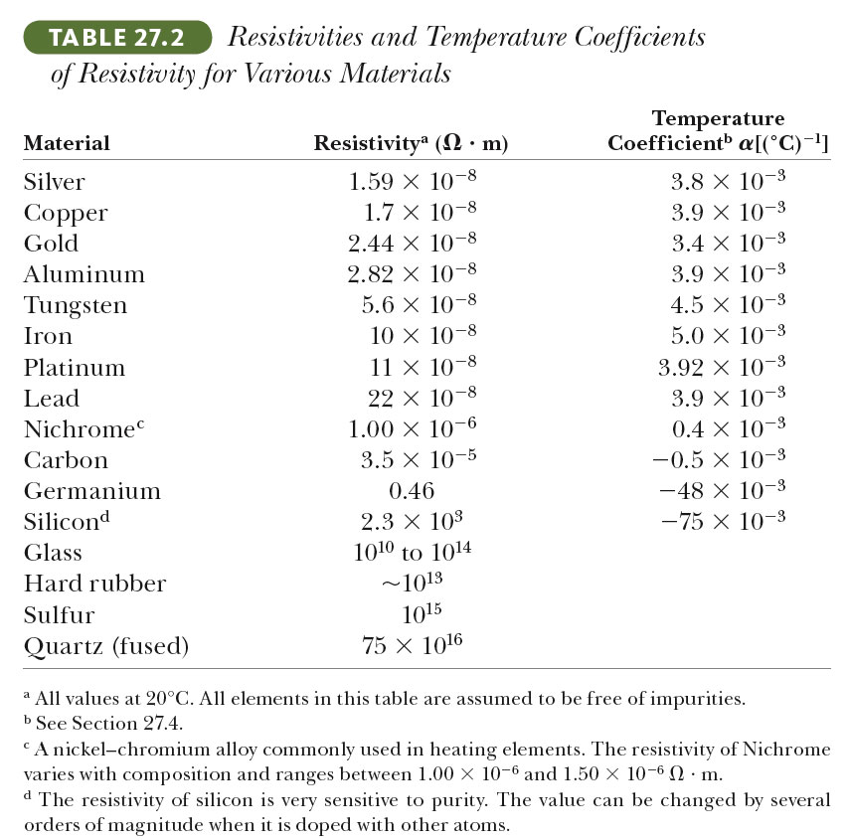
Resistivity Values
Section 27.2

Slide 23
Resistance and Resistivity, Summary
Every ohmic material has a characteristic resistivity that depends on the properties of the material and on temperature.
  Resistivity is a property of substances.
The resistance of a material depends on its geometry and its resistivity.
  Resistance is a property of an object.
An ideal conductor would have zero resistivity.
An ideal insulator would have infinite resistivity.
Section 27.2
Notes:
A copper wire with 10 m length and 20 m length have the same resistivity but different resistance

Slide 24
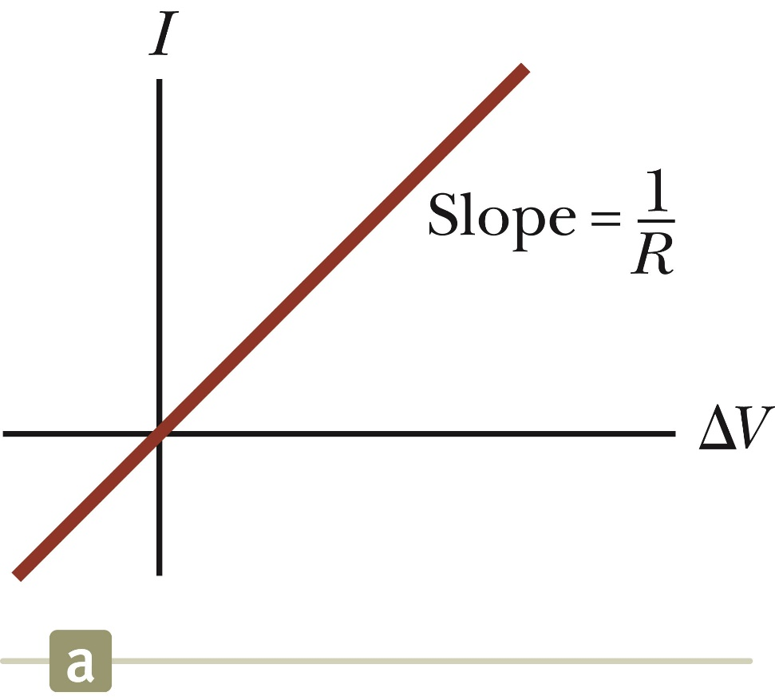
Ohmic Material, Graph
An ohmic device
The resistance is constant over a wide range of voltages.
The relationship between current and voltage is linear.
The slope is related to the resistance.
Section 27.2

Slide 25
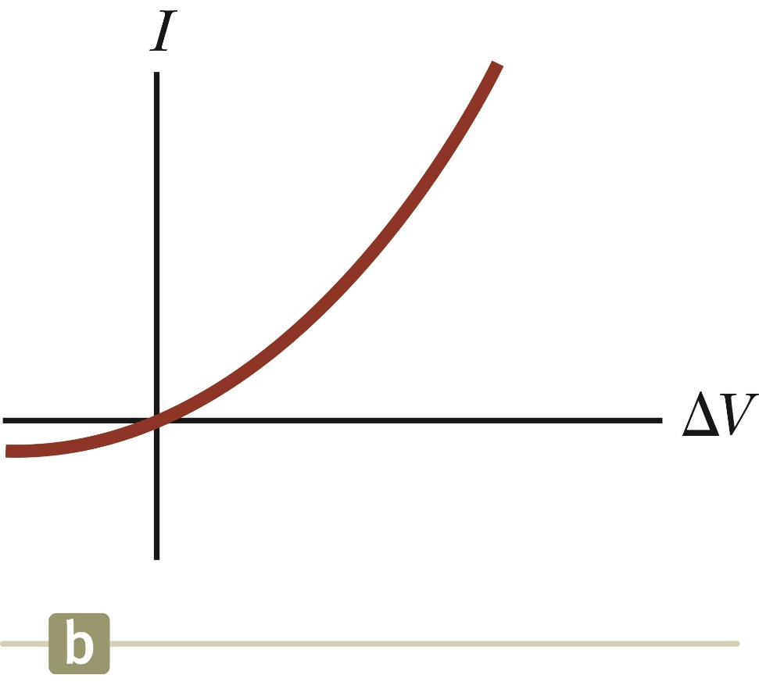
Nonohmic Material, Graph
Nonohmic materials are those whose resistance changes with voltage or current.
The current-voltage relationship is nonlinear.
A junction diode is a common example of a nonohmic device.
Section 27.2

Slide 26



The Resistance of Nichrome Wire, Example
Section 27.2
Notes:
Rho is the resistivity

Slide 27
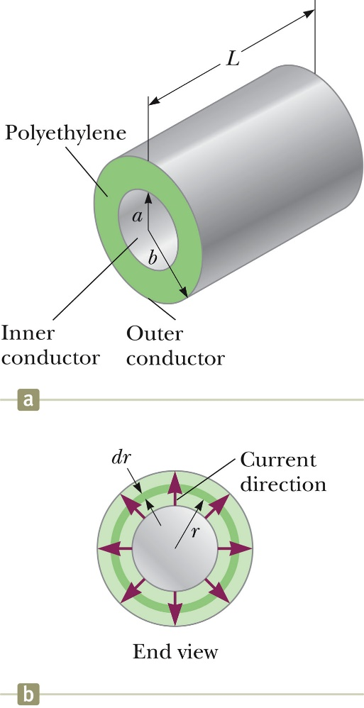
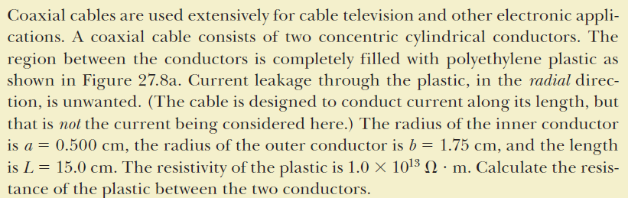

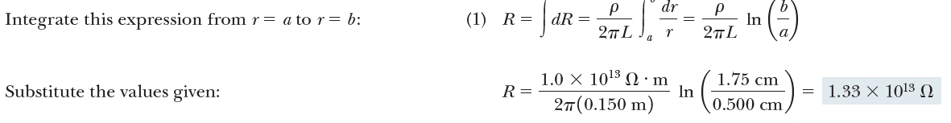
Resistance of a Cable, Example
Section 27.2

Slide 28
Electrical Conduction – A Model
Treat a conductor as a regular array of atoms plus a collection of free electrons.
  The free electrons are often called conduction electrons.
  These electrons become free when the atoms are bound in the solid.
In the absence of an electric field, the motion of the conduction electrons is random.
  Their speed is on the order of 10⁶ m/s.
Section 27.3

Slide 29
Conduction Model, 2
When an electric field is applied, the conduction electrons are given a drift velocity.
Assumptions:
  The electron’s motion after a collision is independent of its motion before the collision.
  The excess energy acquired by the electrons in the electric field is transferred to the atoms of the conductor when the electrons and atoms collide.
    This causes the temperature of the conductor to increase.
Section 27.3

Slide 30

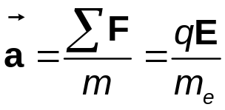
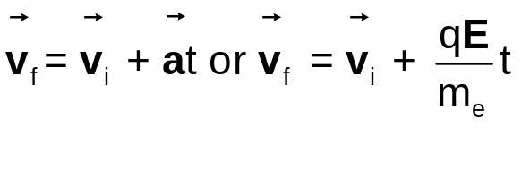
Conduction Model – Calculating the Drift Velocity
The force experienced by an electron is
From Newton’s Second Law, the acceleration is
Applying a motion equation
  Since the initial velocities are random, their average value is zero.
Section 27.3

Slide 31
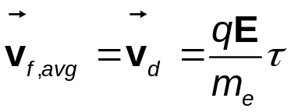

Conduction Model, 4
Let τ be the average time interval between successive collisions.
The average value of the final velocity is the drift velocity.
This is also related to the current density: J = nqv_{d}
  n is the number of charge carriers per unit volume.
Section 27.3
Notes:
J = n q vd

Slide 32

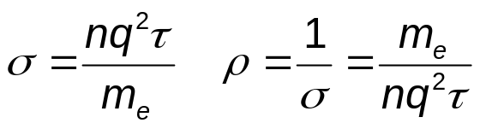
Conduction Model, final
Using Ohm’s Law , expressions for the conductivity and resistivity of a conductor can be found:
Note, according to this classical model, the conductivity and the resistivity do not depend on the strength of the field.
  This feature is characteristic of a conductor obeying Ohm’s Law.
Section 27.3

Slide 33

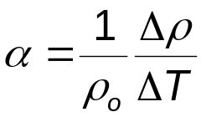
Resistance and Temperature
Over a limited temperature range, the resistivity of a conductor varies approximately linearly with the temperature.
  ρ_{o} is the resistivity at some reference temperature T_{o}
    T_{o} is usually taken to be 20° C
    α is the temperature coefficient of resistivity
      SI units of α are ºC⁻¹
The temperature coefficient of resistivity can be expressed as
Section 27.4

Slide 34
Temperature Variation of Resistance
Since the resistance of a conductor with uniform cross sectional area is proportional to the resistivity, you can find the effect of temperature on resistance.
R = R_{o}[1 + α(T - T_{o})]
Use of this property enables precise temperature measurements through careful monitoring of the resistance of a probe made from a particular material.
Section 27.4

Slide 35
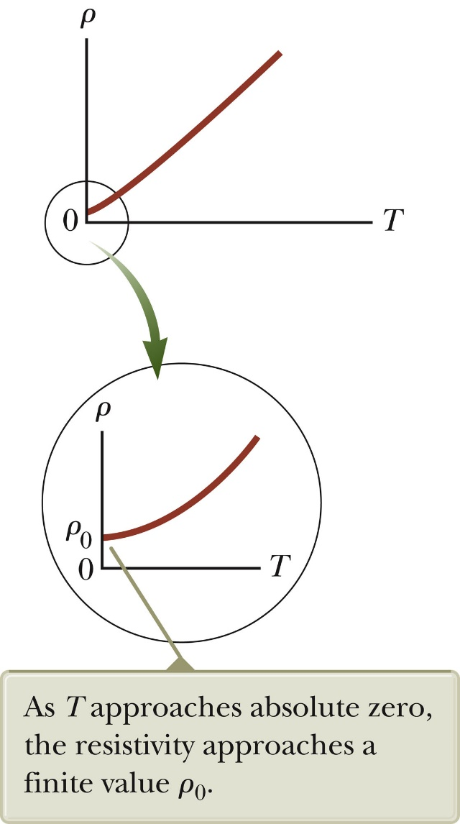
Resistivity and Temperature, Graphical View
For some metals, the resistivity is nearly proportional to the temperature.
A nonlinear region always exists at very low temperatures.
The resistivity usually reaches some finite value as the temperature approaches absolute zero.
Absolute zero: zero kelvin, or minus 459.67 degrees Fahrenheit (minus 273.15 degrees Celsius)
Section 27.4

Slide 36
Residual Resistivity
The residual resistivity near absolute zero is caused primarily by the collisions of electrons with impurities and imperfections in the metal.
High temperature resistivity is predominantly characterized by collisions between the electrons and the metal atoms.
  This is the linear range on the graph.
Section 27.4

Slide 37
Semiconductors
Semiconductors are materials that exhibit a decrease in resistivity with an increase in temperature.
α is negative
There is an increase in the density of charge carriers at higher temperatures.
Section 27.4

Slide 38
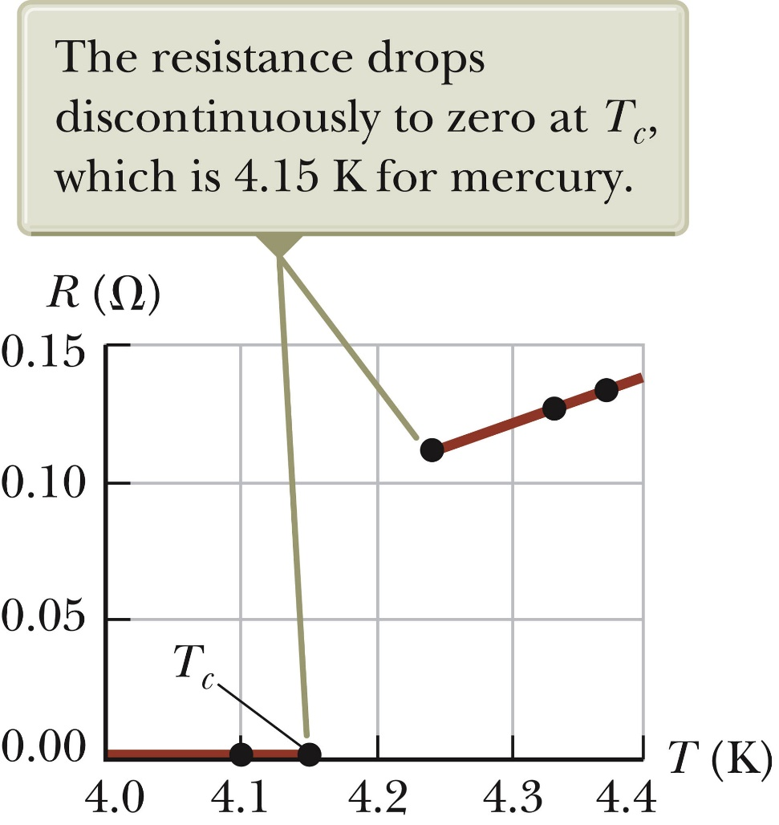
Superconductors
A class of materials and compounds whose resistances fall to virtually zero below a certain temperature, T_{C.}
  T_{C} is called the critical temperature.
The graph is the same as a normal metal above T_{C}, but suddenly drops to zero at T_{C.}
Section 27.5

Slide 39
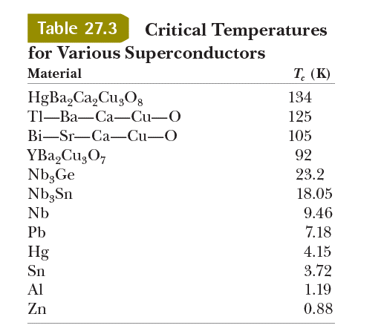
Superconductors, cont
The value of T_{C} is sensitive to:
  chemical composition
  pressure
  molecular structure
Once a current is set up in a
superconductor, it persists without
any applied voltage.
  Since R = 0
Section 27.5

Slide 40
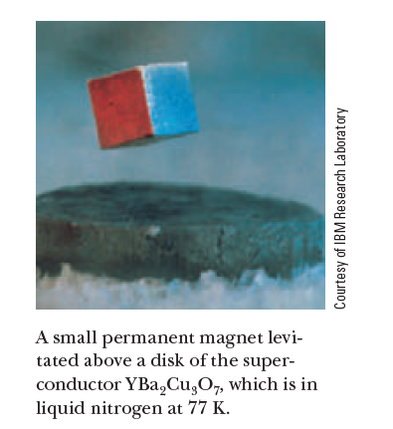
Superconductor Application
An important application of superconductors is a superconducting magnet.
The magnitude of the magnetic field is about 10 times greater than a normal electromagnet.
These magnets are being considered as a means of storing energy.
Are currently used in MRI units, which produce high-quality images of internal organs without the need for excessive exposure of patients to x-rays or other harmful radiation.
Section 27.5
Notes:
MRI: medical magnetic
resonance imaging

Slide 41
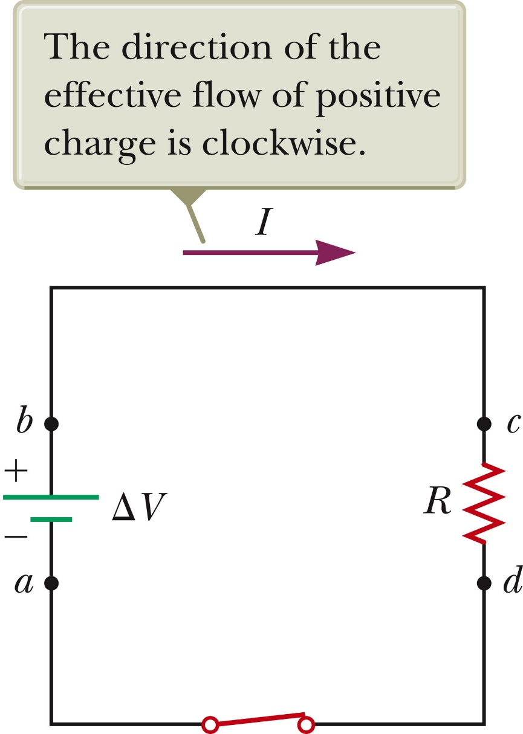
Electrical Power
Assume a circuit as shown
The entire circuit is the system.
As a positive charge moves clockwise from a to b, the electric potential energy of the system increases by QΔV.
  The chemical energy in the battery must decrease by this same amount.
This electric potential energy is transformed into internal energy in the resistor.
  Corresponds to increased vibrational motion of the atoms in the resistor
Section 27.6

Slide 42

Electric Power, 2
The resistor is normally in contact with the air, so its increased temperature will result in a transfer of energy by heat into the air.
The resistor also emits thermal radiation.
After some time interval, the resistor reaches a constant temperature.
  The input of energy from the battery is balanced by the output of energy by heat and radiation.
The rate at which the system’s potential energy decreases as the charge passes through the resistor is equal to the rate at which the system gains internal energy in the resistor.
The power is the rate at which the energy is delivered to the resistor.
Section 27.6

Slide 43
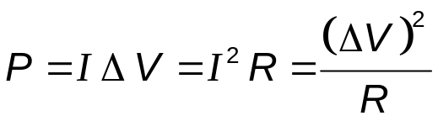
Electric Power, final
The power is given by the equation P = I ΔV.
Applying Ohm’s Law, alternative expressions can be found:
Units: I is in A, R is in Ω, ΔV is in V, and P is in W
Section 27.6

Slide 44
Some Final Notes About Current
A single electron is moving at the drift velocity in the circuit.
  It may take hours for an electron to move completely around a circuit.
The current is the same everywhere in the circuit.
  Current is not “used up” anywhere in the circuit
The charges flow in the same rotational sense at all points in the circuit.

Slide 45
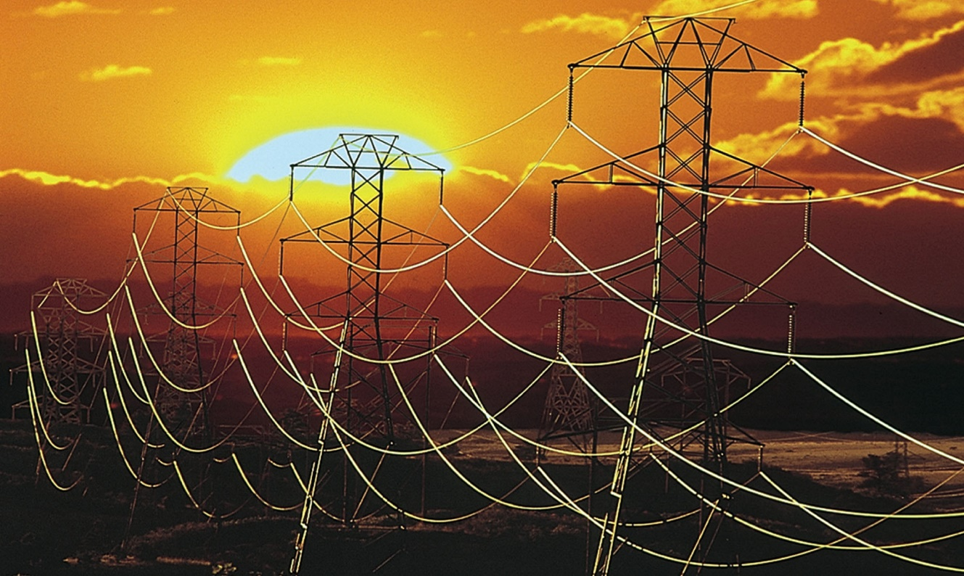
Electric Power Transmission
Real power lines have resistance.
Power companies transmit electricity at high voltages and low currents to minimize power losses.

Slide 46
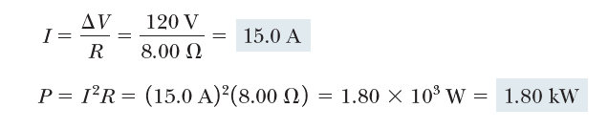
Power in an Electric Heater, Example

